Slide 1
ARRAY MULTIPLIER

Slide 2
CONTENTS
Requirement
Principle
Implementation and Simulation
Advantages and Disadvantages
Conclusion

Slide 3
Requirement
As we know multiplication is an essential arithmetic operation. It makes easy in in finding squares , powers , also used for signal convolution in signal processing, used for image coding, filtering

Slide 4
Principle
Serial Multiplication (Shift-Add)
Computing partial products by anding multiplicand and multiplier bits bit by bit.
Adding the partial products by multiplying each multiplicand with multiplier and shift to left by one bit for every multiplier bit.
Add bits under same position must be added.

Slide 5
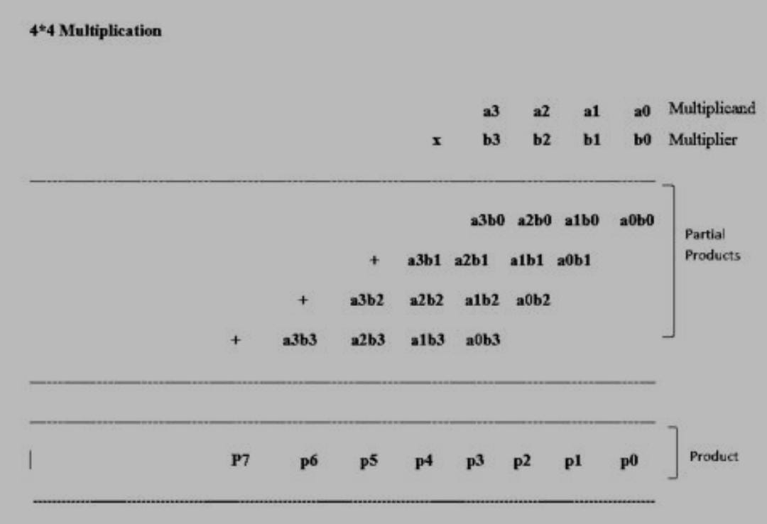
4*4 bit multiplication principle

Slide 6
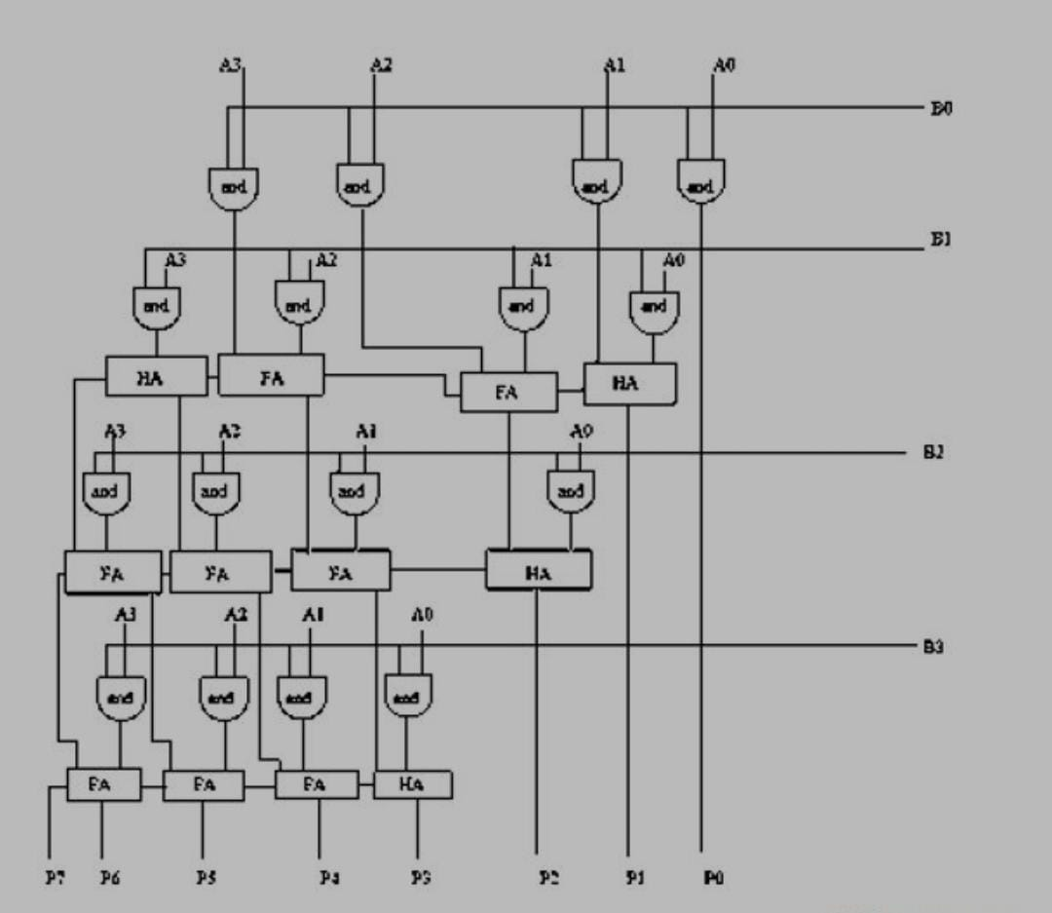
4 – bit array multiplier block diagram

Slide 7
Simulation & implementation
HALF ADDER MODULE :-
module HA(sout,cout,a,b);
output sout,cout;
input a,b;
assign sout = a^b;
assign cout=(a&b);
endmodule

Slide 8
Full adder module :-
module FA(sout,cout,a,b,cin);
output sout,cout;
input a,b,cin;
assign sout = (a^b^cin);
assign cout=((a&b)|(a&cin)|(b&cin));
endmodule

Slide 9
Multiplier Module :
module Arraymultiplier4bit(product,A,B);
input [3:0]A;
input [3:0]B;
output [7:0]product;
assign product[0]=(A[0]&B[0]);
wire c1,c2,c3,c4,c5,c6,c7,c8,c9,c10,c11,c12,c13,c14,c15,c16,c17;
HA HA1(product[1],c1,(A[1]& B[0]),(A[0]&B[1]));
FA FA1(c2,c3,A[1]&B[1],(B[0]&A[2]),c1);
FA FA2(c4,c5,(B[1]&A[2]),(B[0]&A[3]),c3);
HA HA2(c6,c7,(B[1]&A[3]),c5);
HA HA3(product[2],c15,c2,(B[2]&A[0]));
FA FA5(c14,c16,c4,(B[2]&A[1]),c15);
FA FA4(c13,c17,c6,(A[2]&B[2]),c16);
FA FA3(c9,c8,c7,(B[2]&A[3]),c17);
HA HA4(product[3],c12,c14,(B[3]&A[0]));
FA FA8(product[4],c11,c13,(B[3]&A[1]),c12);
FA FA7(product[5],c10,c9,(B[3]&A[2]),c11);
FA FA6(product[6],product[7],c8,(A[3]& B[3]),c10);
endmodule

Slide 10
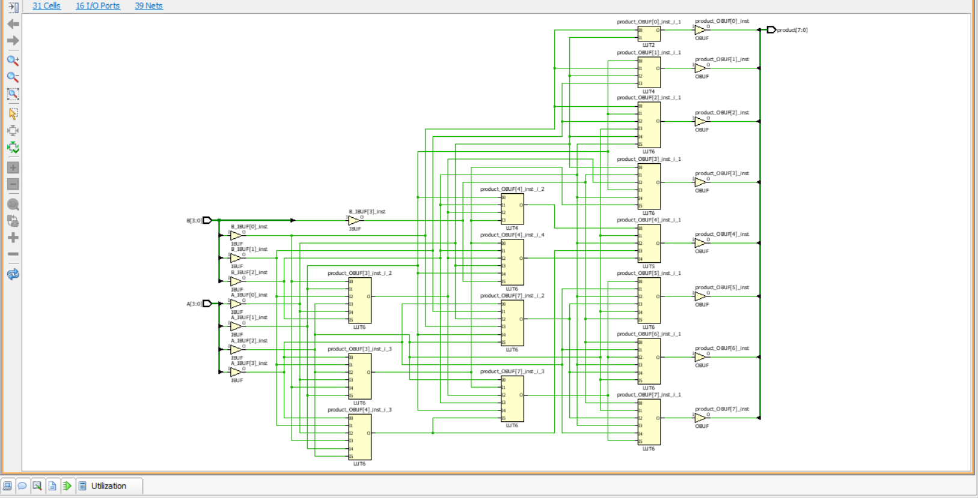
Simulation circuit

Slide 11
Advantages & disadvantages
Advantages :-
Minimum complexity
Easily scalable
Easily pipe lined
Regular shape
Disadvantages :-
High power consumption
Large area requirement for scalability

Slide 12
Conclusions :-
Array multiplier is simulated and implemented in Verilog
We can increase the performance using pipeline technique
Array multiplier has better performance than serial multiplication scheme.

